Slide 1
GENETIC DISORDER, HPO, OMIM and ClinVar
Nov 23 2024
Giảng viên: TS. Lưu Phúc Lợi
Luu.p.loi@googlemail.com

Slide 2
Content of Lecture 3
Genetic disorder
Introduction to HPO (The Human Phenotype Ontology)
Introduction to OMIM
Introduction to ClinVar

Slide 3
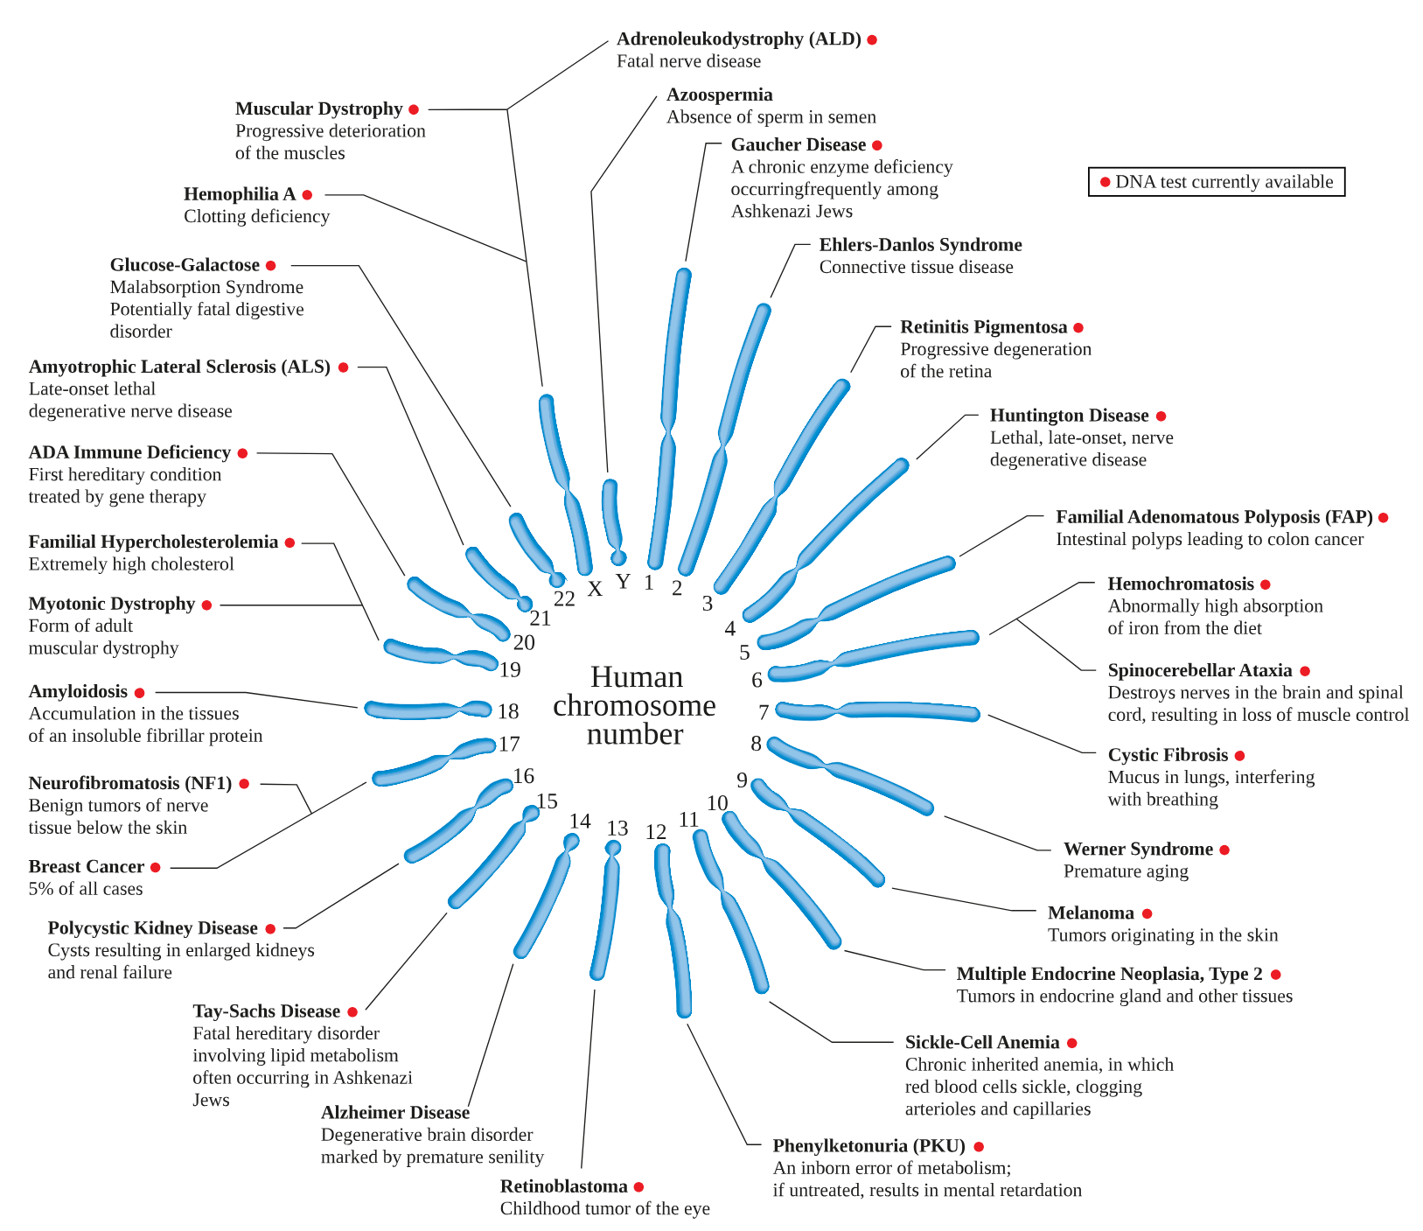
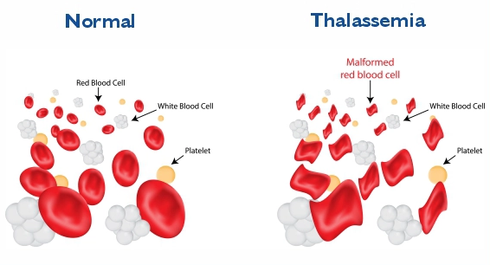
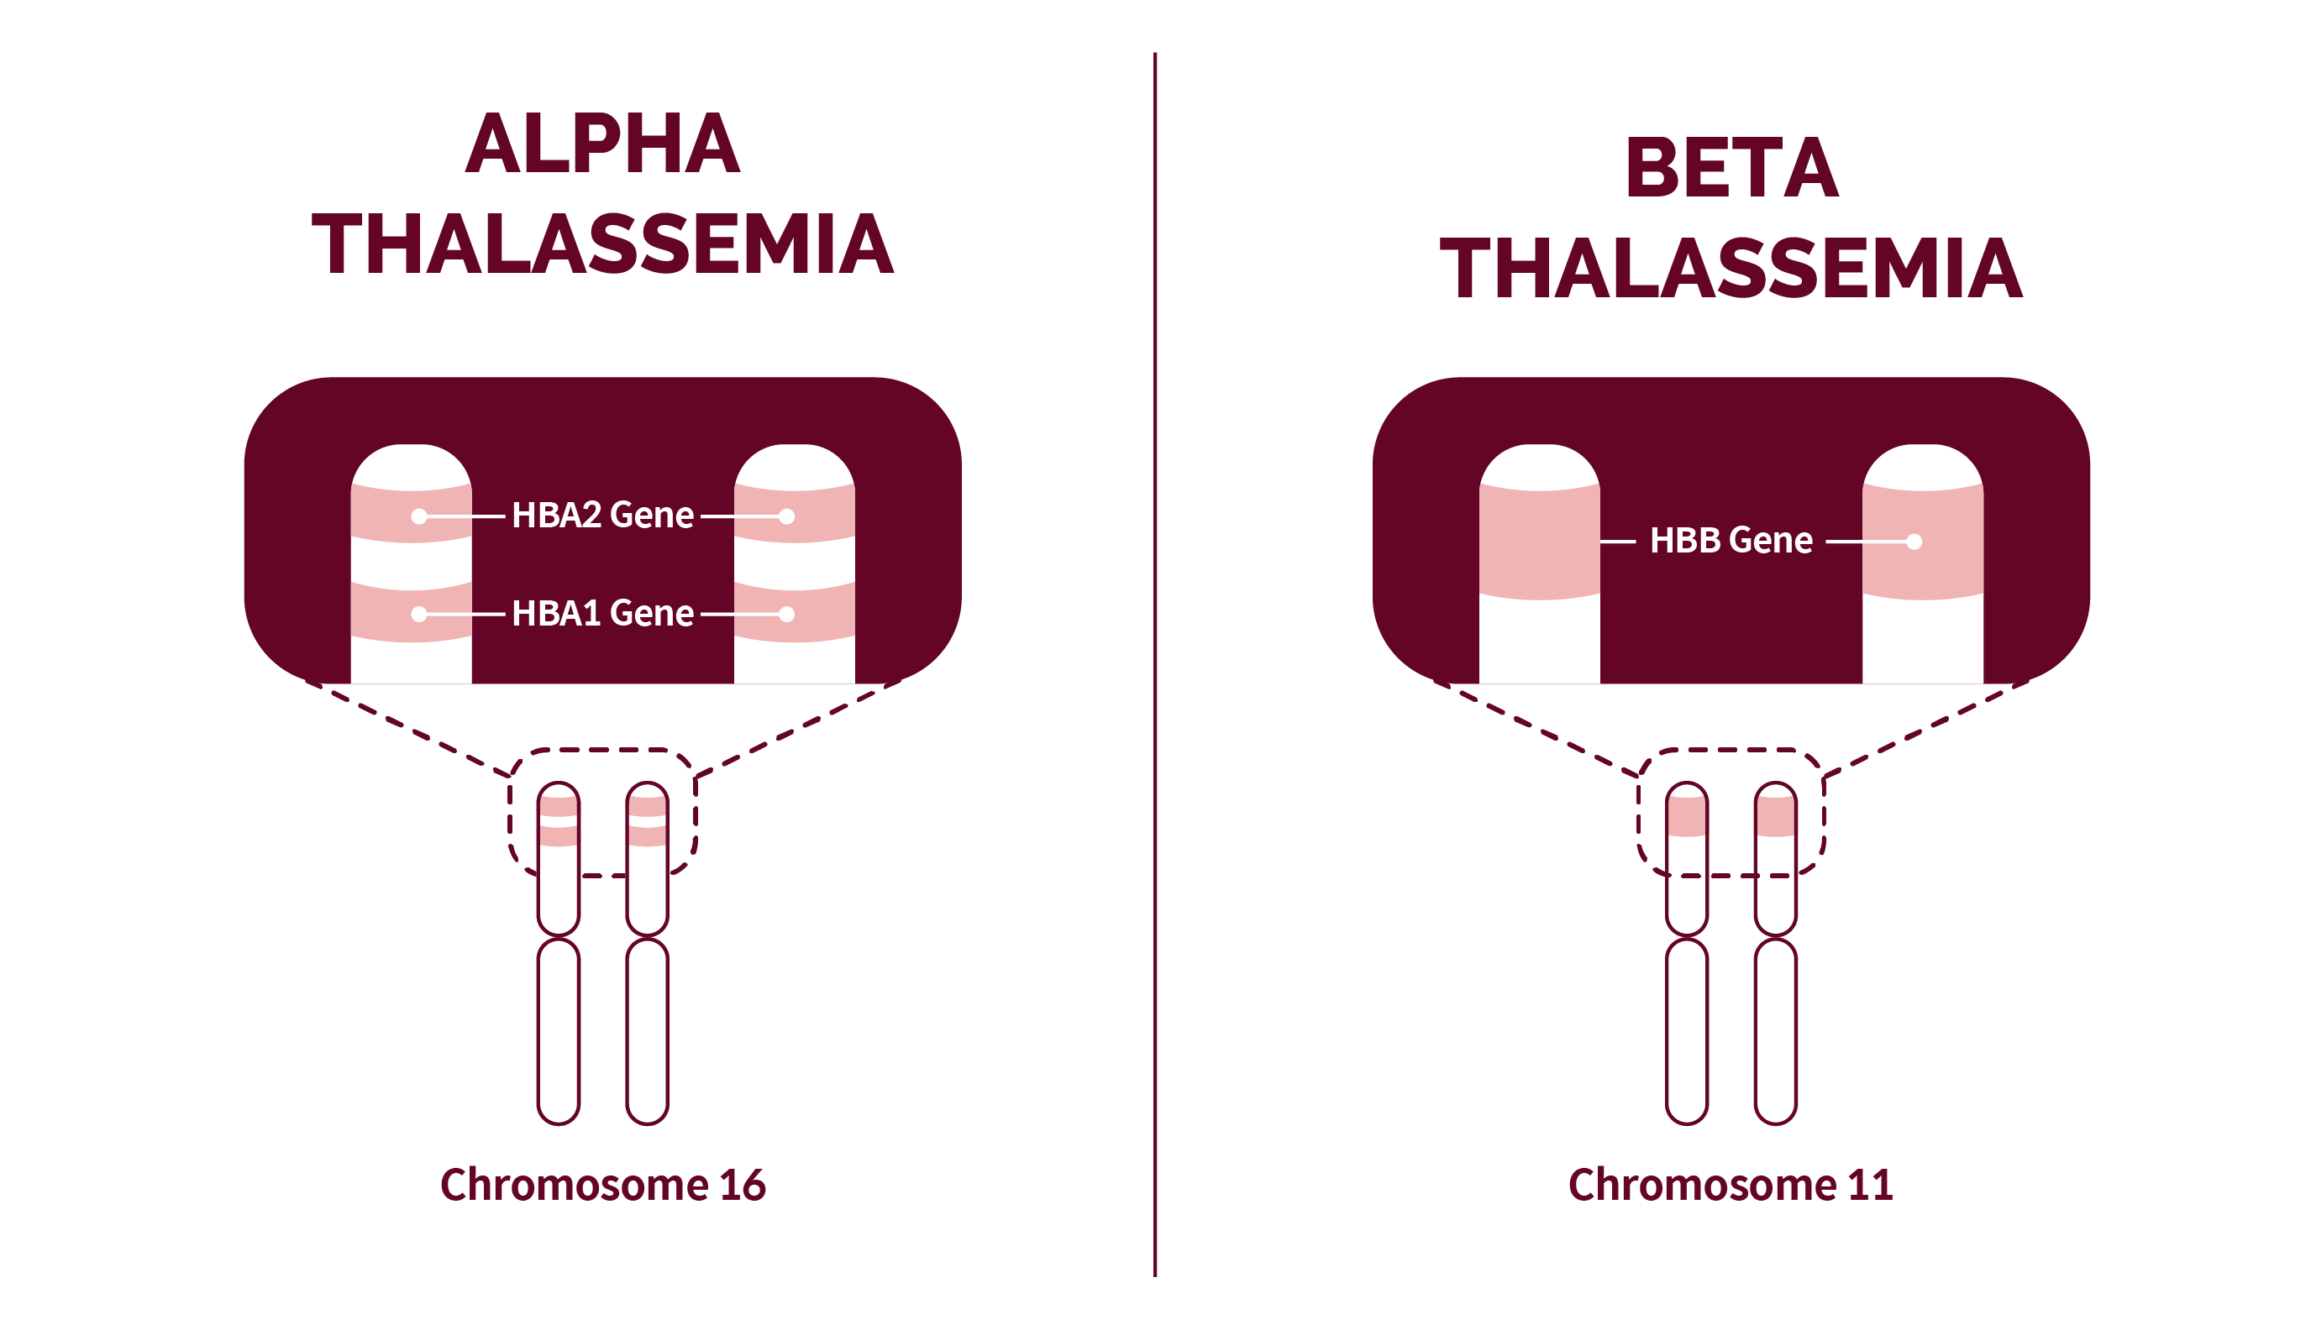
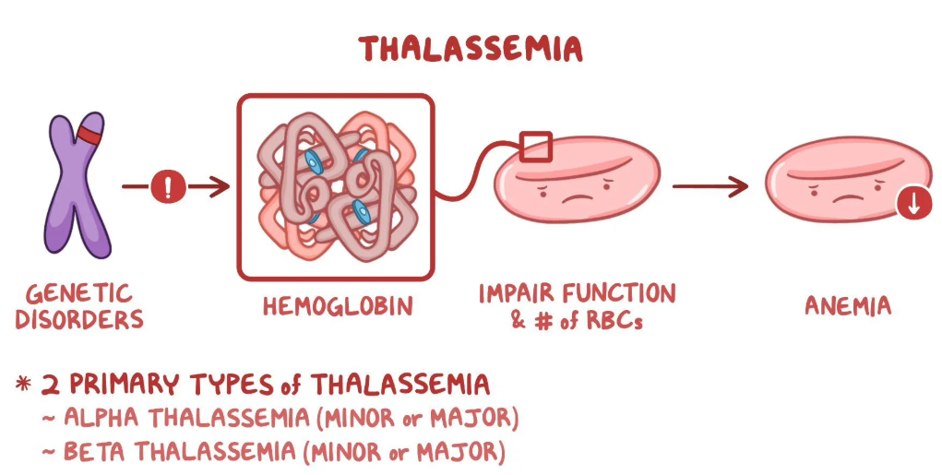
Genetic disorder
A genetic disorder is a health problem caused by one or more abnormalities in the genome. It can be caused by a mutation in a single gene or multiple genes or by a chromosome abnormality.
https://en.wikipedia.org/wiki/Genetic_disorder

Slide 4
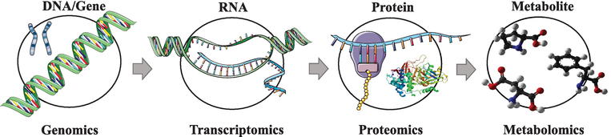
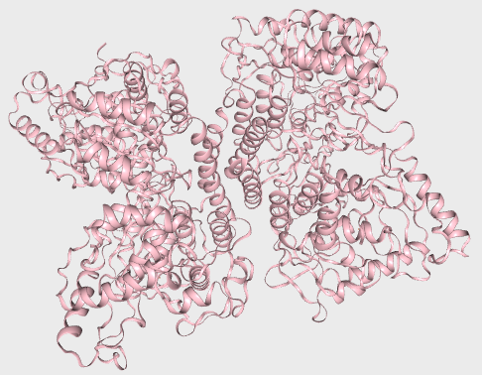
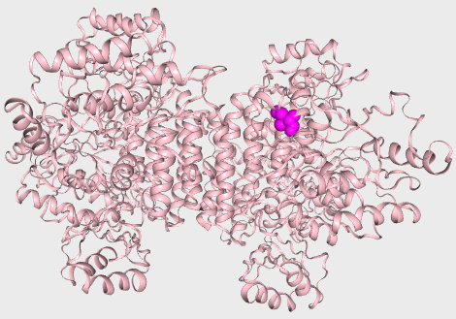
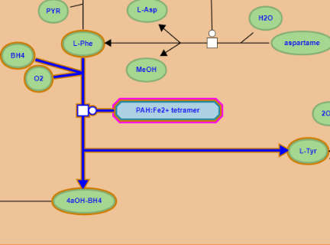
Quan hệ nhân quả: Biến thể gen và bệnh di truyền
PAH gene
Ref …ATCGAT…
P1 …AACGAT…
NM_000277.3(PAH):c.971T>A
PAH mRNA
Ref …AUCGAU…
P1 …AACGAU…
NM_000277.3(PAH):c.971T>A
PAH protein
Ref …Ile-Asp…
P1 …Asn-Asp…
NM_000277.3(PAH):p.Ile324Asn
PAH
Ref Phe → Tyr
PAH
P1 Phe → Tyr
10.5772/intechopen.71769

Slide 5
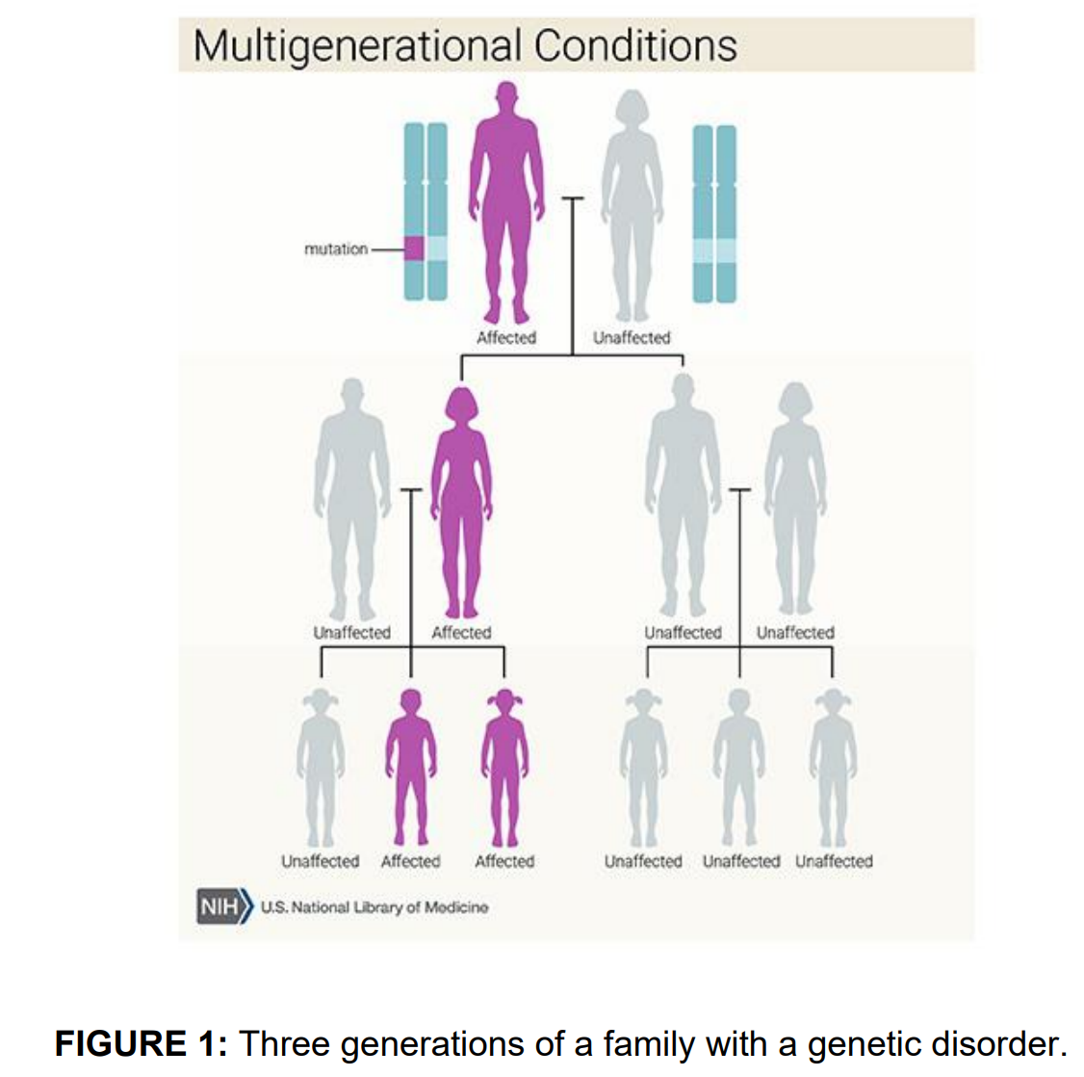
https://medlineplus.gov/genetics/

Slide 6
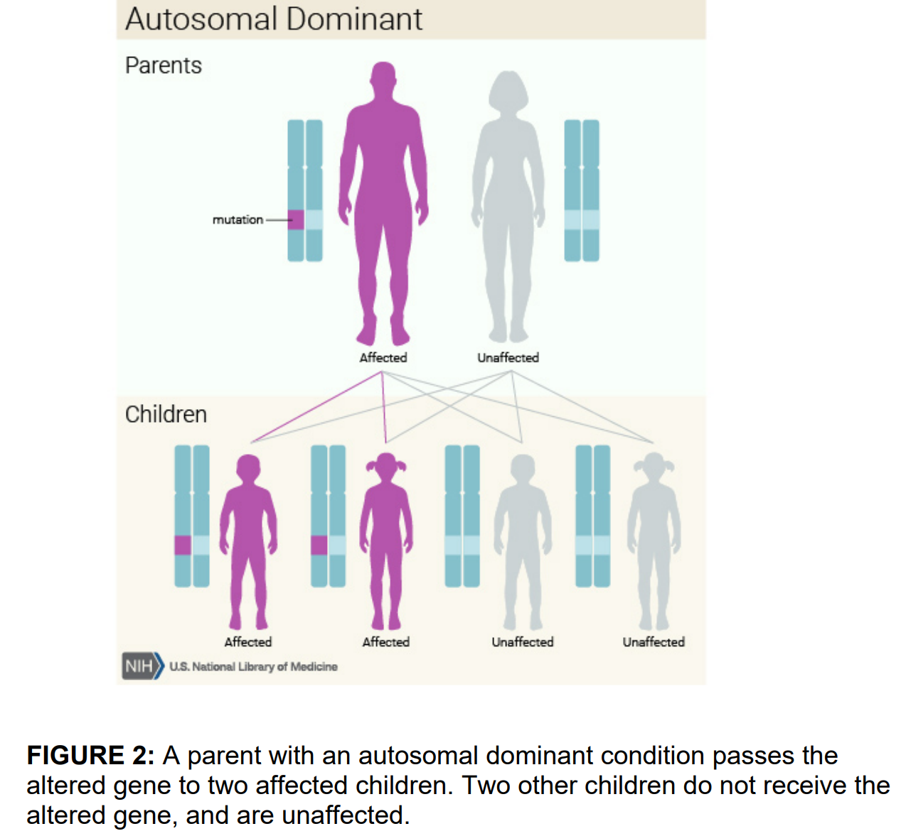
https://medlineplus.gov/genetics/

Slide 7
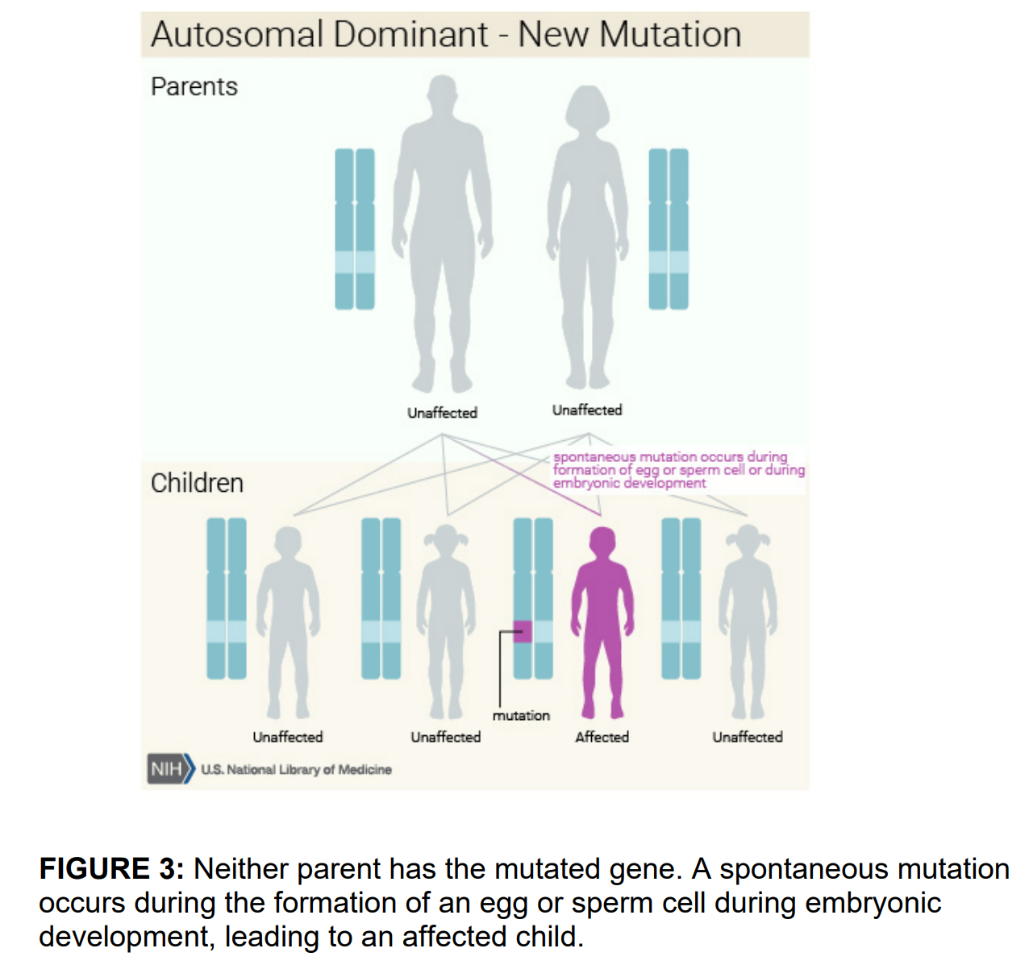

Slide 8
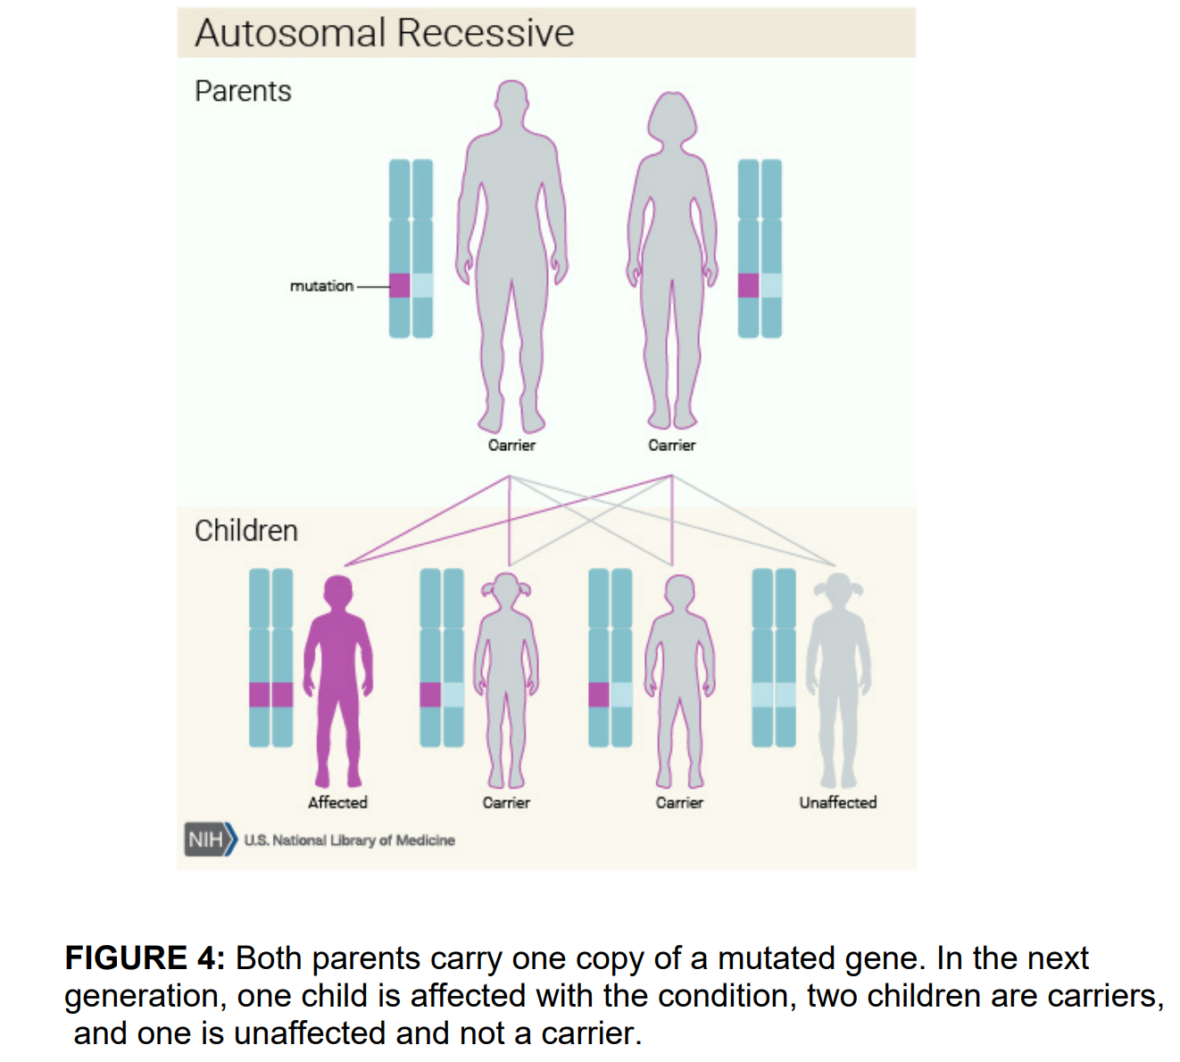
https://medlineplus.gov/genetics/

Slide 9
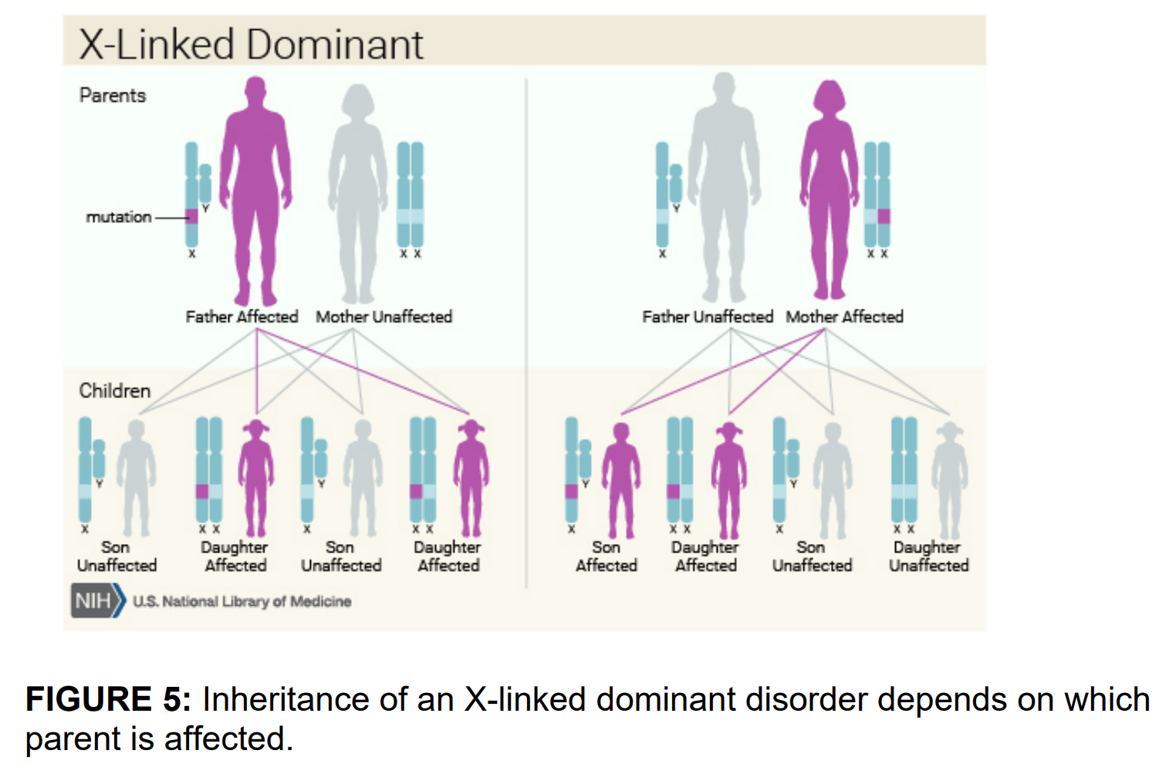
https://medlineplus.gov/genetics/

Slide 10
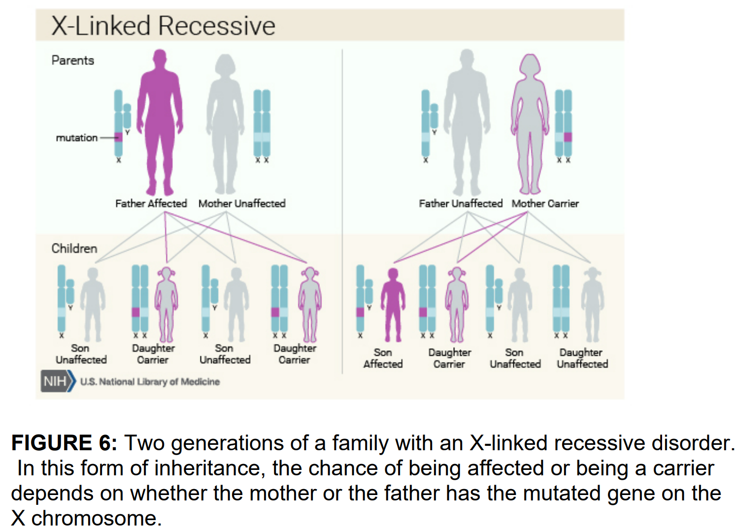
https://medlineplus.gov/genetics/

Slide 11
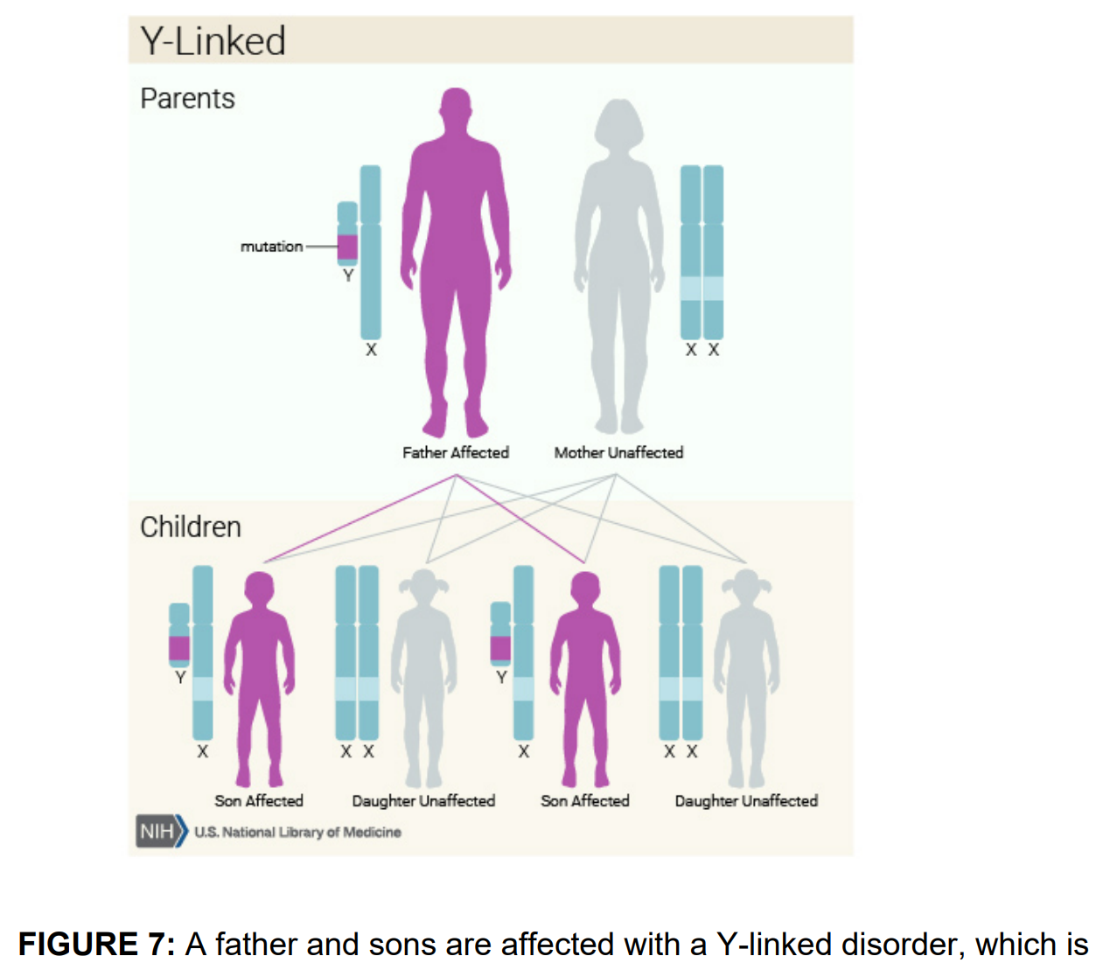
https://medlineplus.gov/genetics/

Slide 12
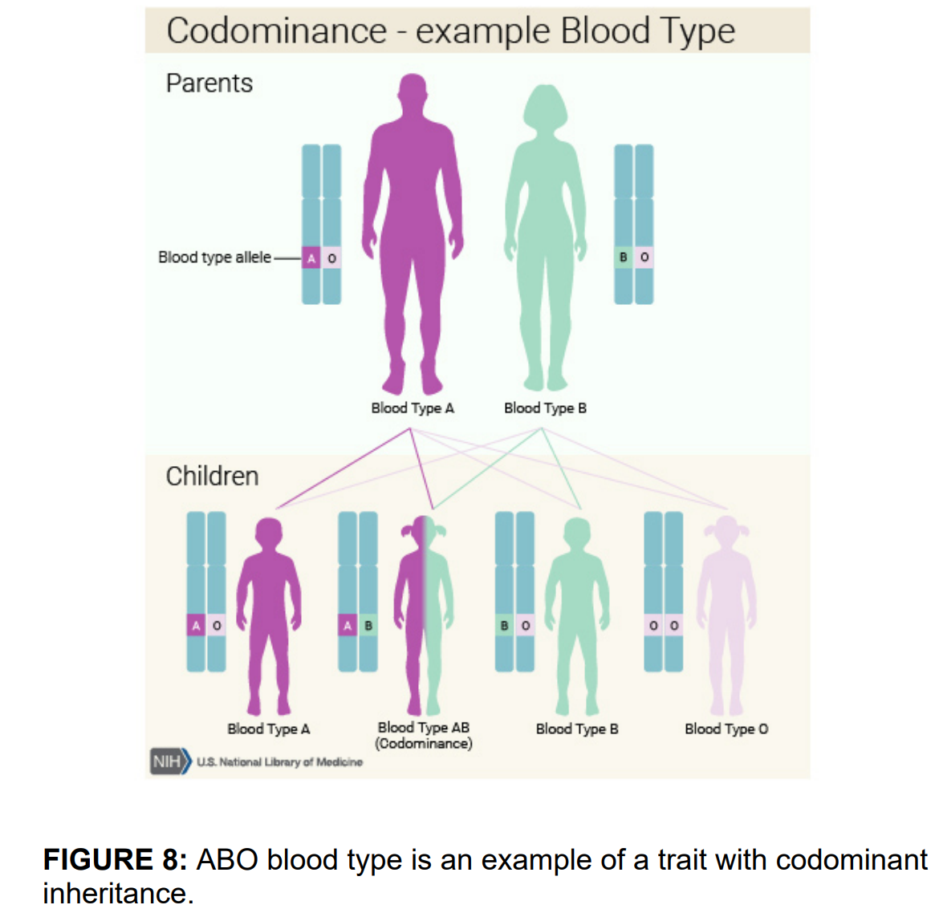
https://medlineplus.gov/genetics/

Slide 13
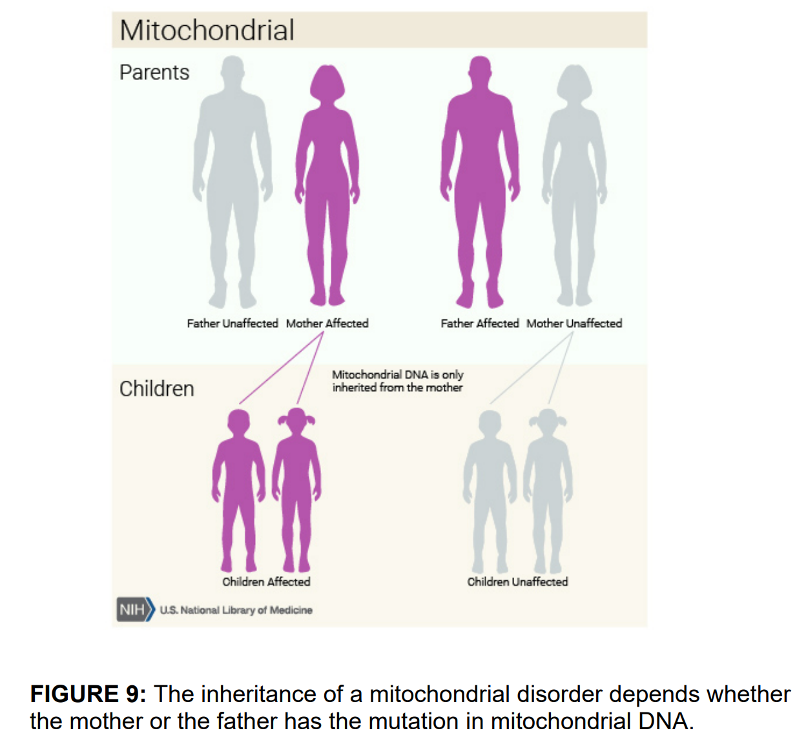
https://medlineplus.gov/genetics/

Slide 14
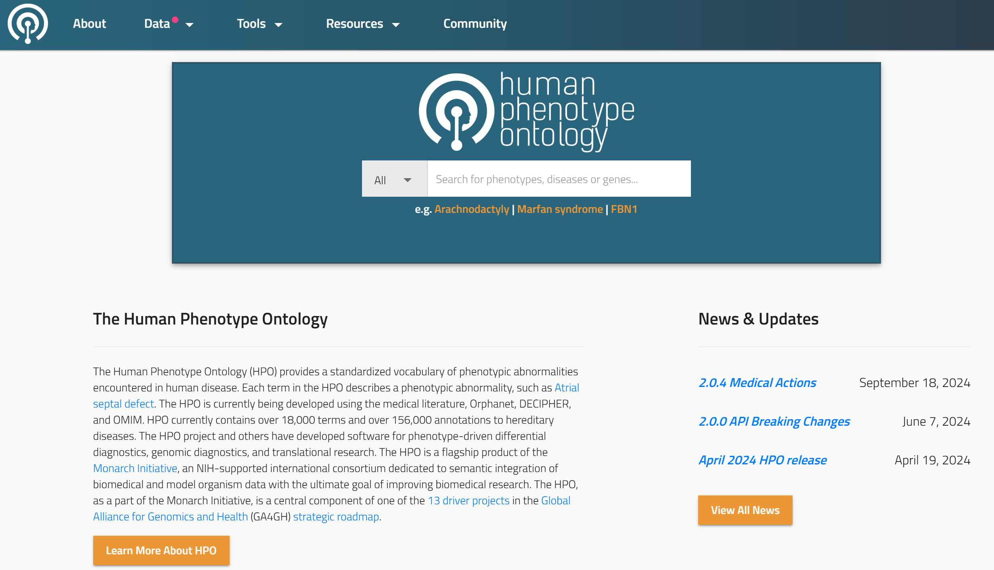
The Human Phenotype Ontology (HPO)
https://hpo.jax.org/

Slide 15
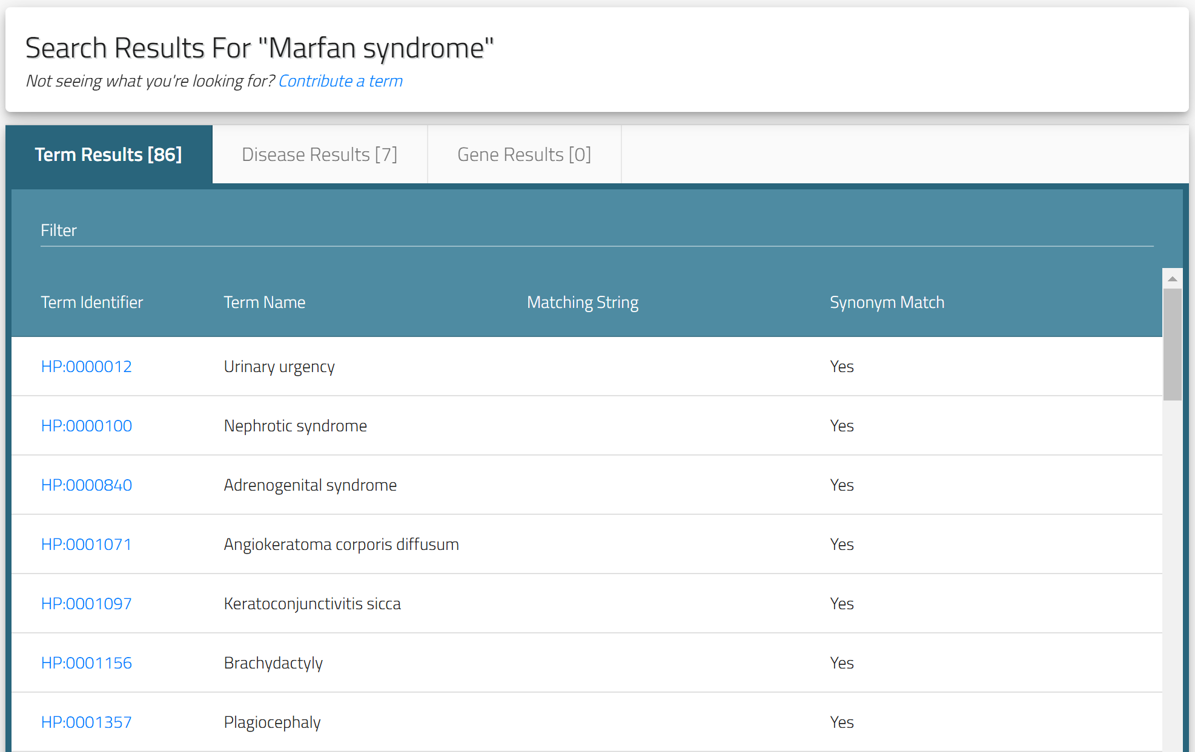
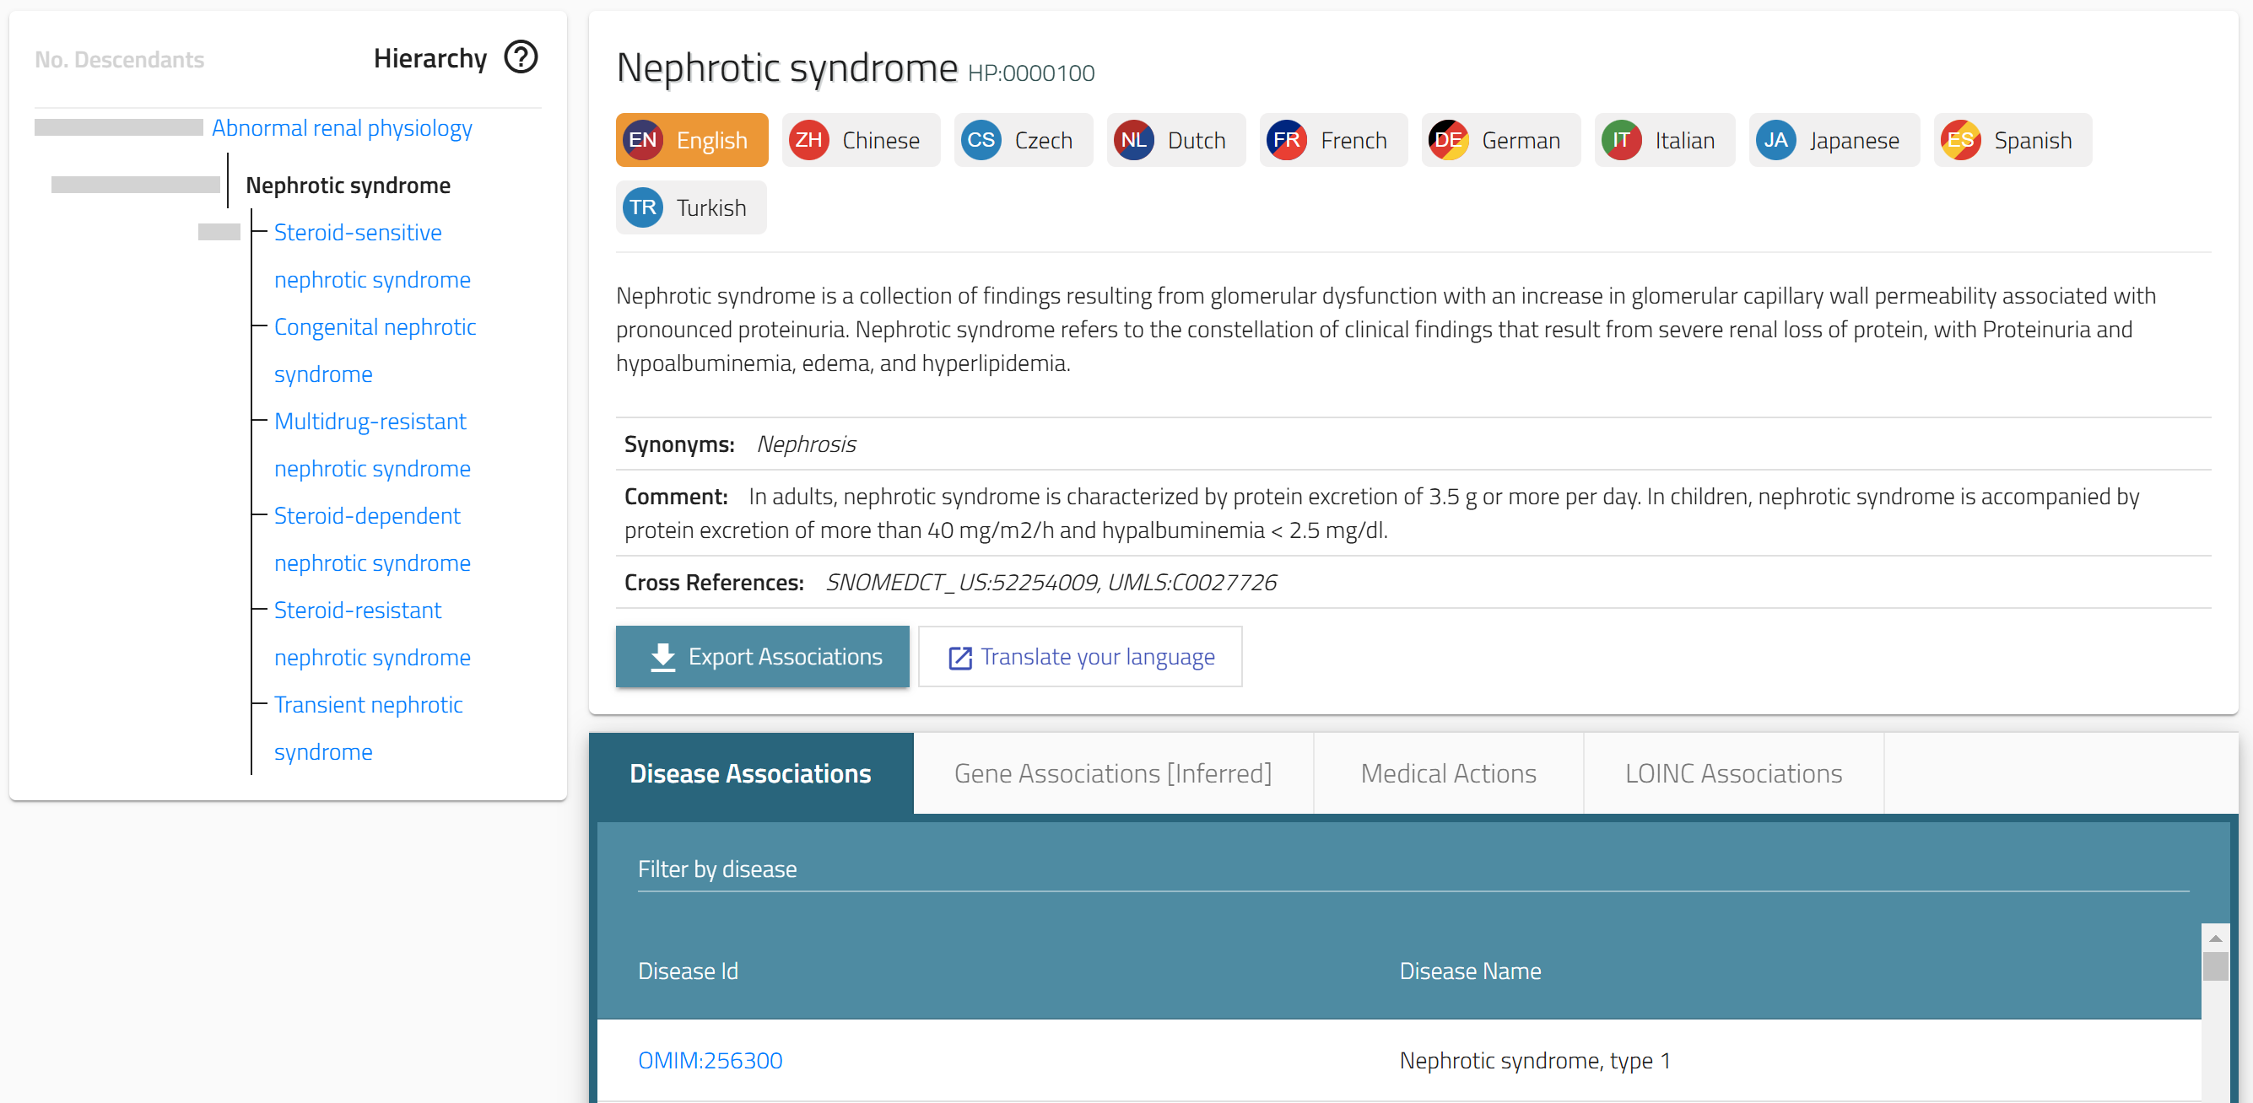
The Human Phenotype Ontology (HPO)
The Human Phenotype Ontology (HPO) provides a standardized vocabulary of phenotypic abnormalities encountered in human disease.
Each term in the HPO describes a phenotypic abnormality, such as Atrial septal defect.
The HPO is currently being developed using the medical literature, Orphanet, DECIPHER, and OMIM.
HPO currently contains over 18,000 terms and over 156,000 annotations to hereditary diseases.
The HPO project and others have developed software for phenotype-driven differential diagnostics, genomic diagnostics, and translational research.
https://hpo.jax.org/

Slide 16
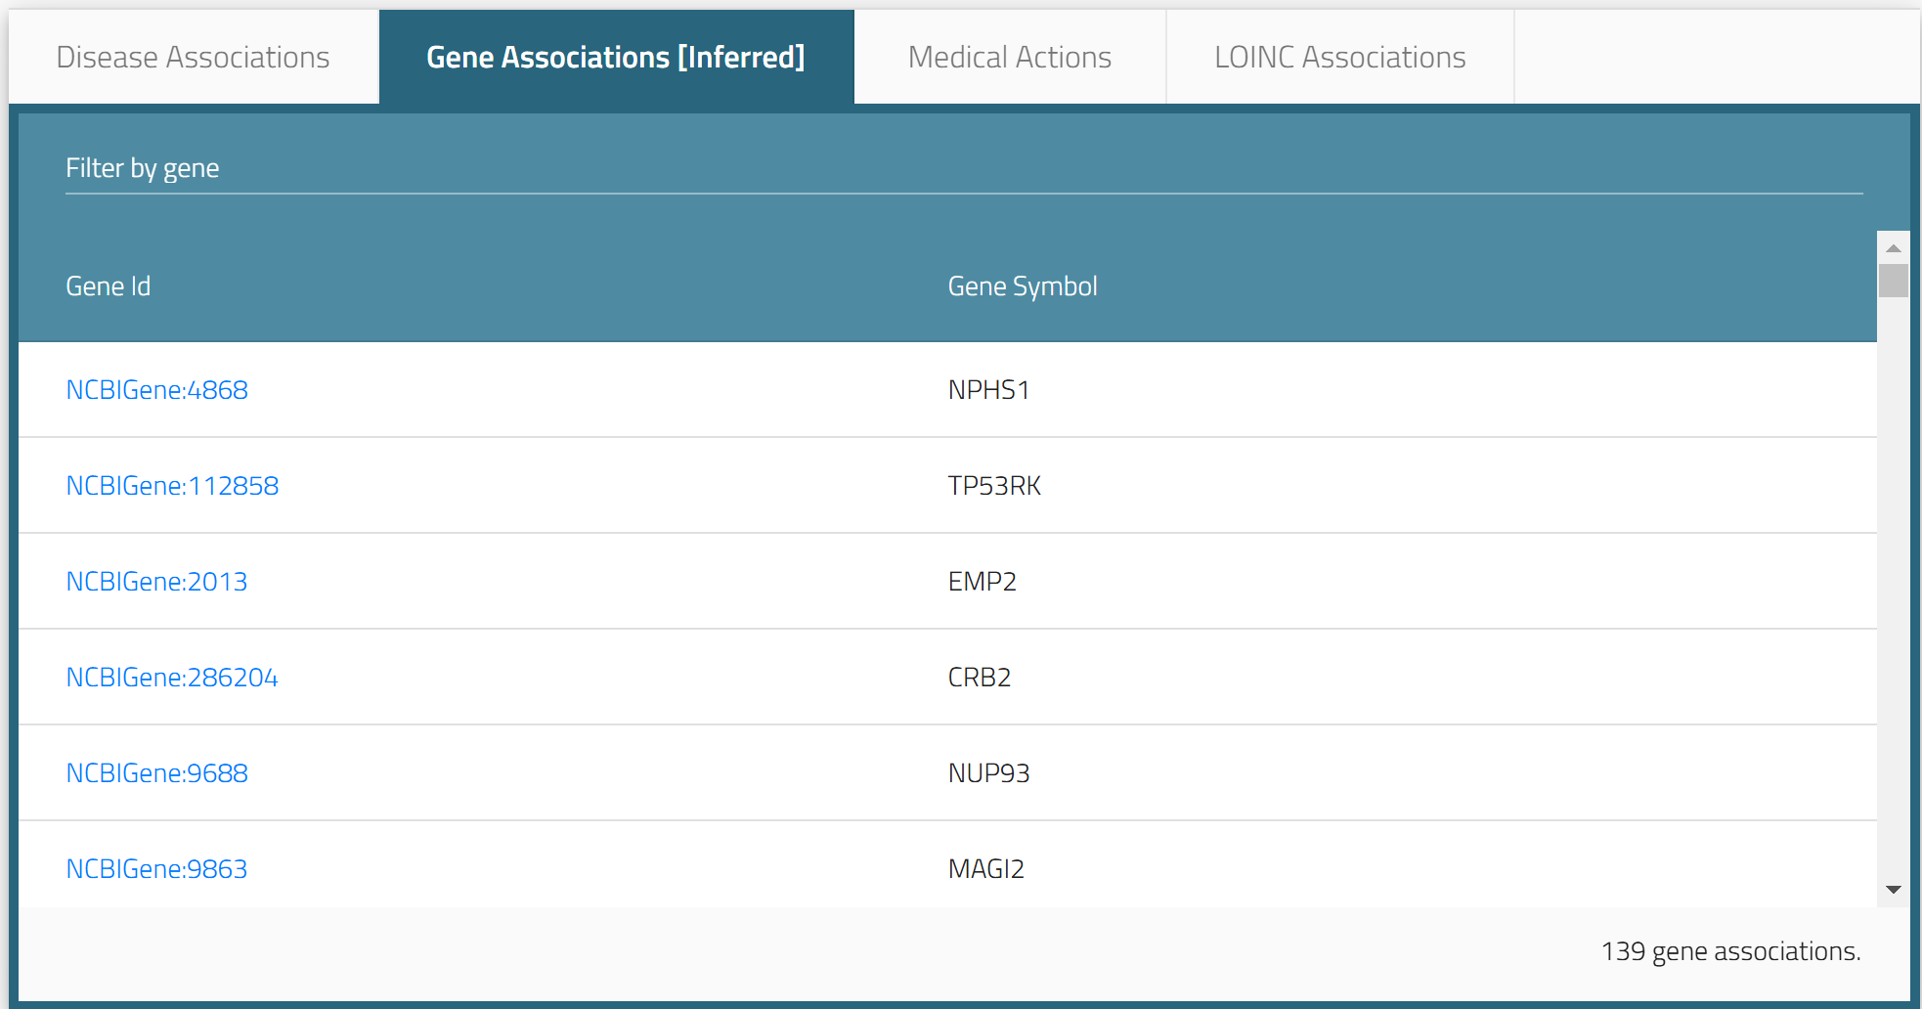
The Human Phenotype Ontology (HPO)
https://hpo.jax.org/browse/term/HP:0000100

Slide 17
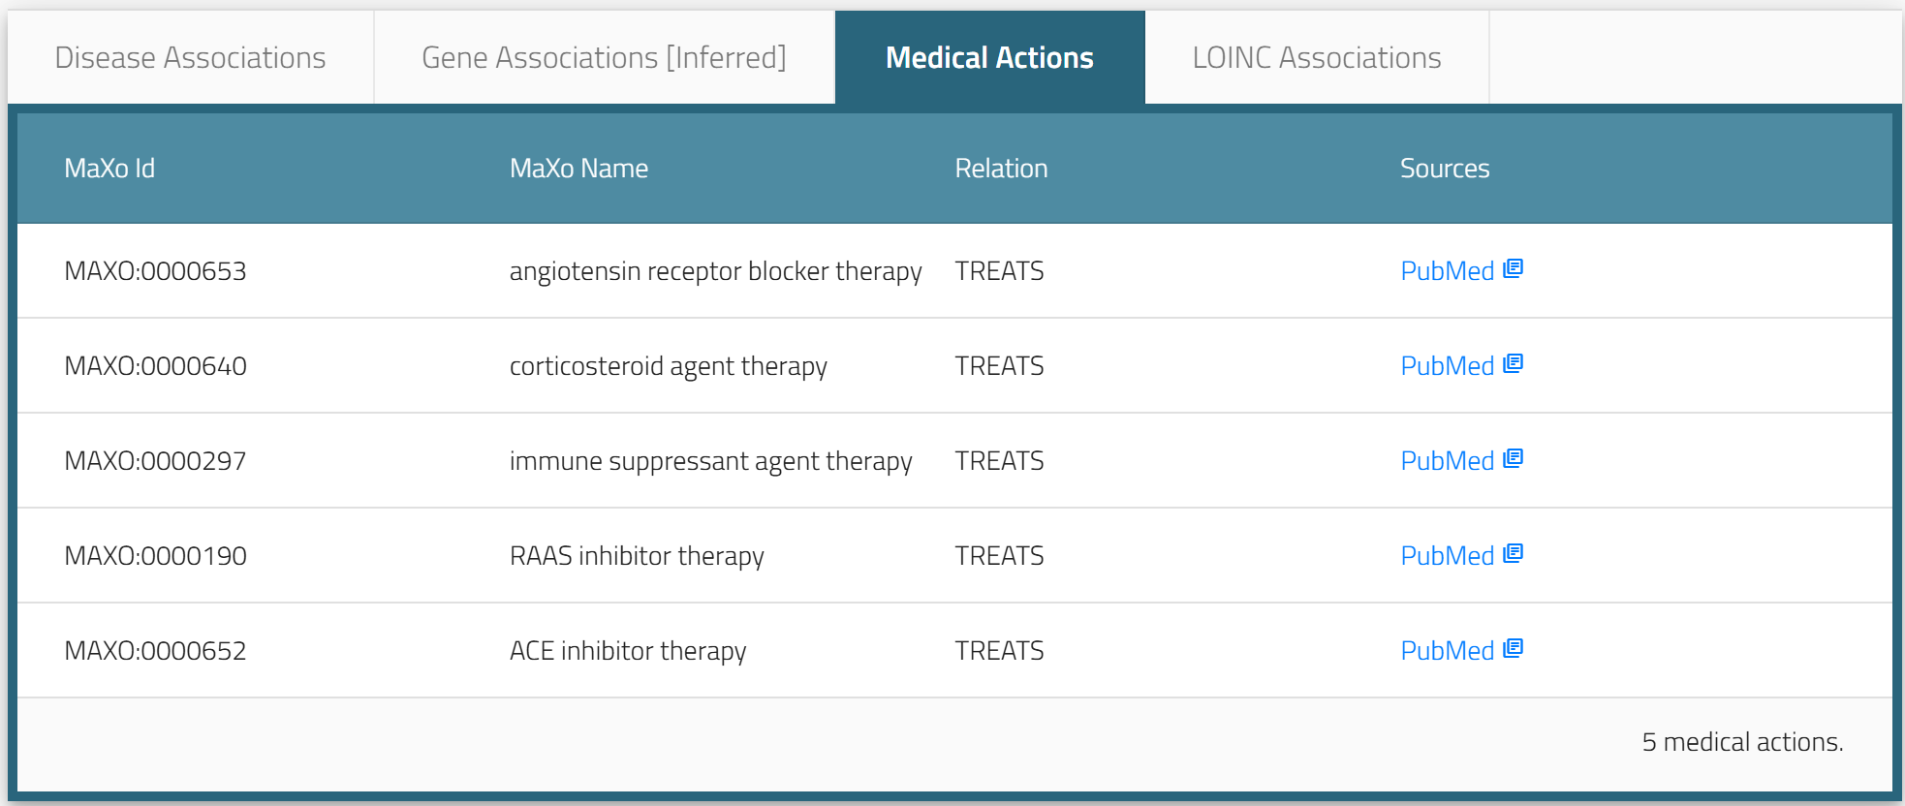
The Human Phenotype Ontology (HPO)
https://hpo.jax.org/browse/term/HP:0000100

Slide 18
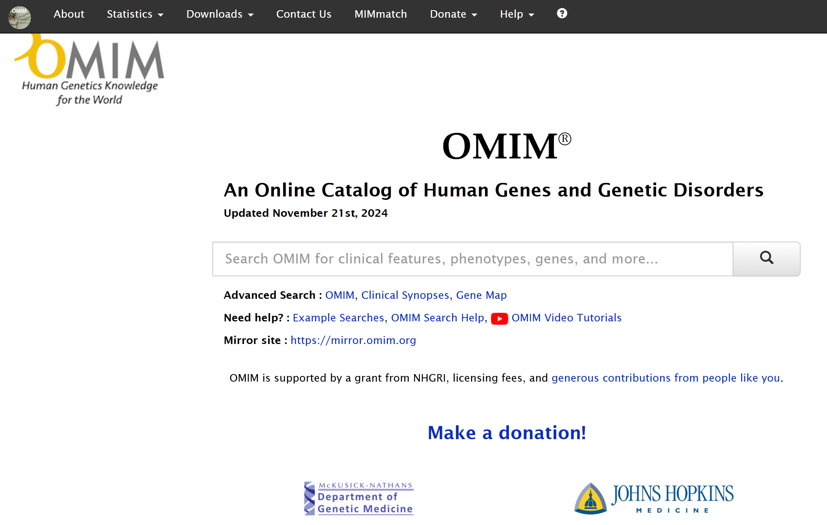
OMIM: An Online Catalog of Human Genes and Genetic Disorders
https://omim.org/

Slide 19
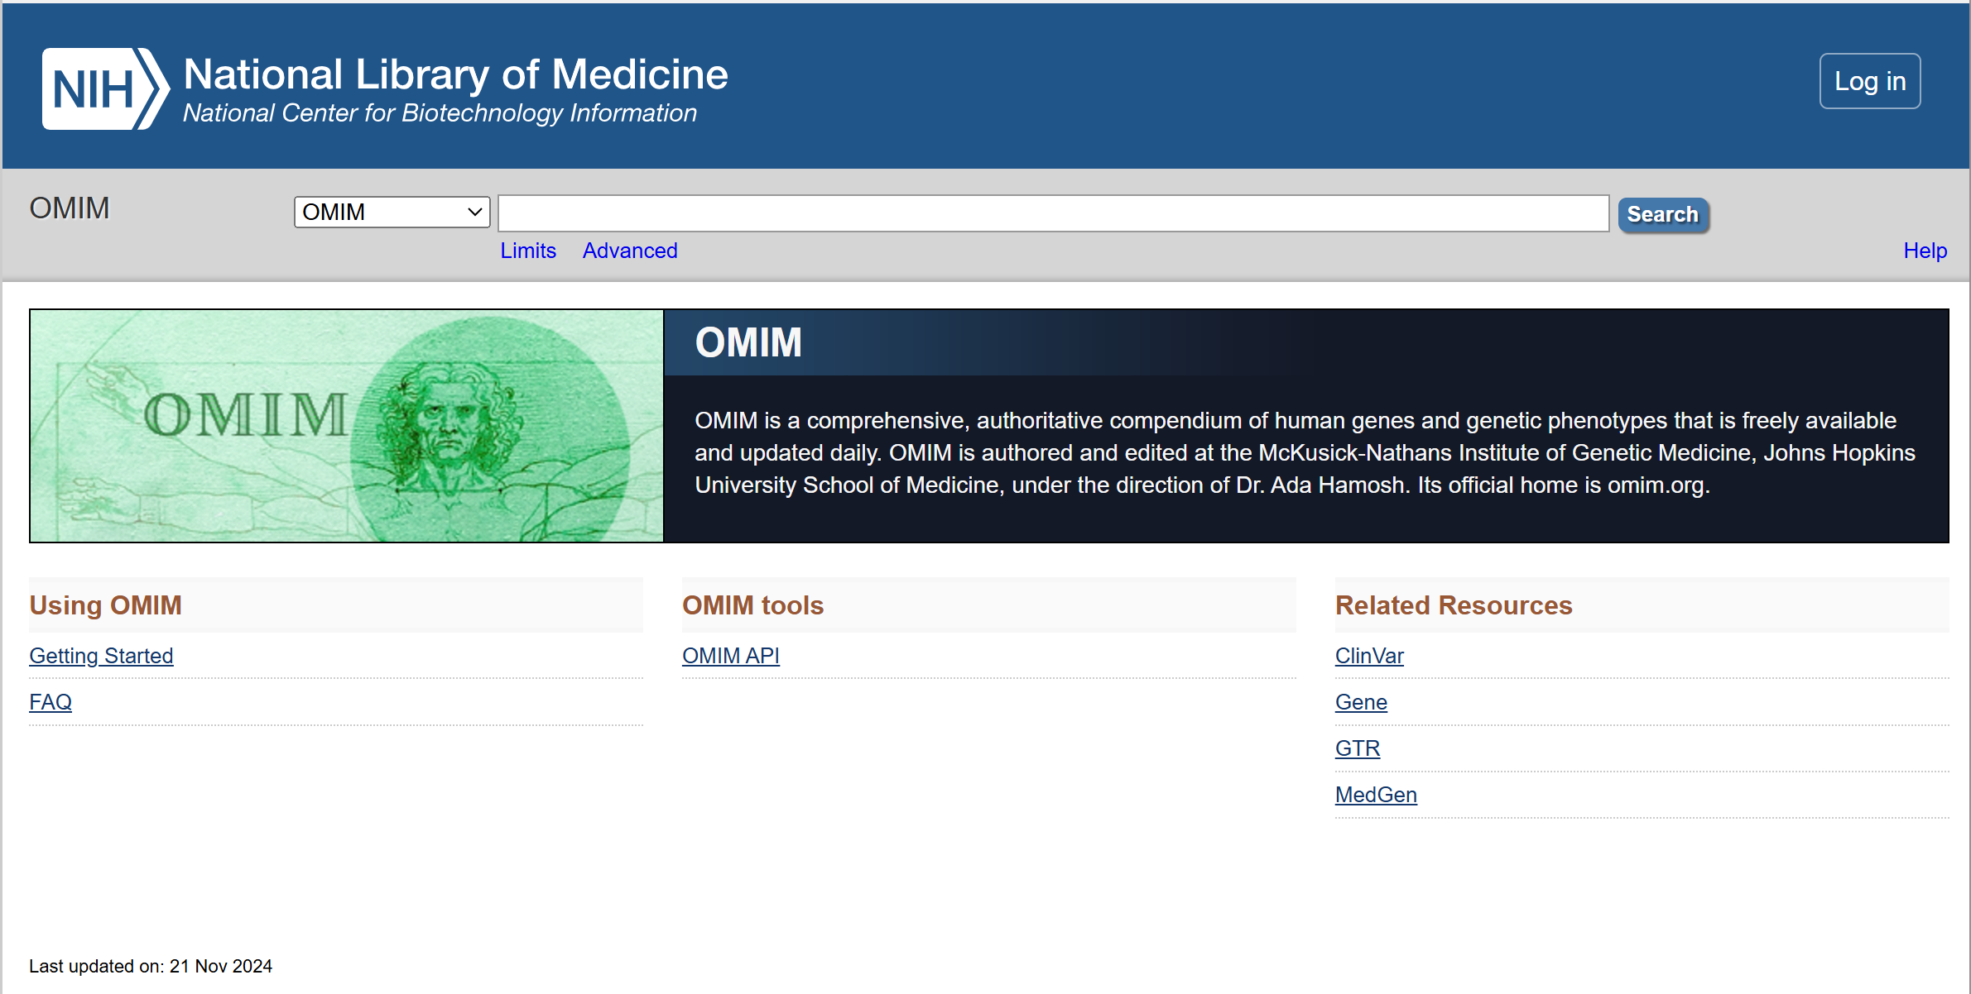
NCBI OMIM: An Online Catalog of Human Genes and Genetic Disorders
https://www.ncbi.nlm.nih.gov/omim

Slide 20
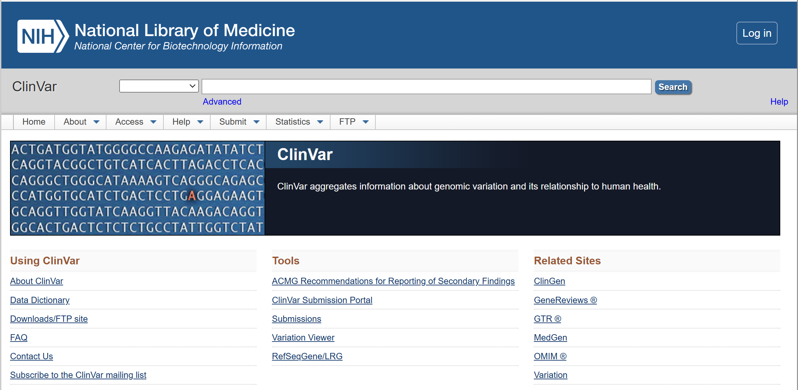
ClinVar: Reports of human variations classified for diseases and drug responses
https://www.ncbi.nlm.nih.gov/clinvar/

Slide 21
Xin chân thành cảm ơn!
Luu Phuc Loi, PhD
Zalo: 0901802182
luu.p.loi@googlemail.com

